Slide 1
Constructor

Slide 2
Constructor
A class constructor is a special member function of a class that is executed whenever we create new objects of that class.
A constructor will have exact same name as the class and it does not have any return type at all, not even void. Constructors can be very useful for setting initial values for certain member variables.
The Compiler calls the Constructor whenever an object is created.
Constructors can be defined either inside the class definition or outside class definition using class name and scope resolution :: operator.

Slide 3
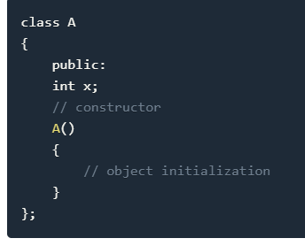
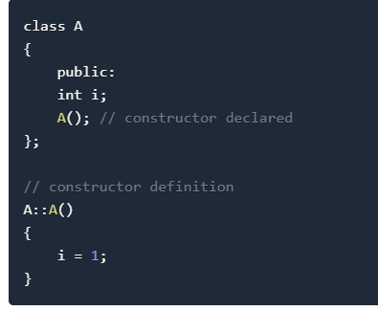
Types of Constructors in C++
Default Constructor
Parametrized Constructor
Copy Constructor

Slide 4
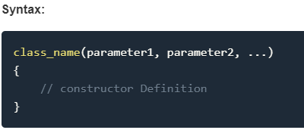
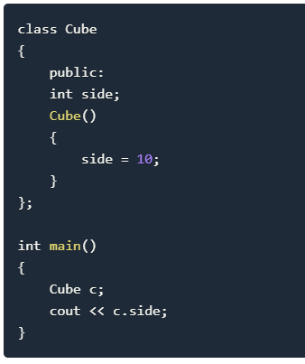
Default Constructor
Default constructor is the constructor which doesn't take any argument. It has no parameter.

Slide 5
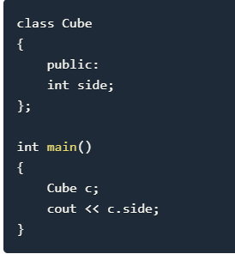
In this case, as soon as the object is created the constructor is called which initializes its data members.
A default constructor is so important for initialization of object members, that even if we do not define a constructor explicitly, the compiler will provide a default constructor implicitly.
In this case, default constructor provided by the compiler will be called which will initialize the object data members to default value, that will be 0 or any random integer value in this case.

Slide 6
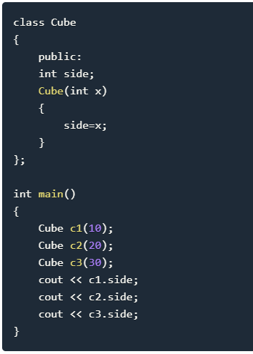
Parametrized Constructor
These are the constructors with parameter. Using this Constructor you can provide different values to data members of different objects, by passing the appropriate values as argument.

Slide 7
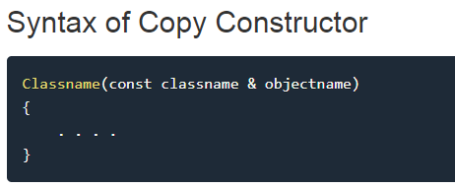
Copy Constructor
Copy Constructor is a type of constructor which is used to create a copy of an already existing object of a class type.
It is usually of the form X (const X& objname), where X is the class name.
The compiler provides a default Copy Constructor to all the classes.
As it is used to create an object, hence it is called a constructor. And, it creates a new object, which is exact copy of the existing copy, hence it is called copy constructor.

Slide 8
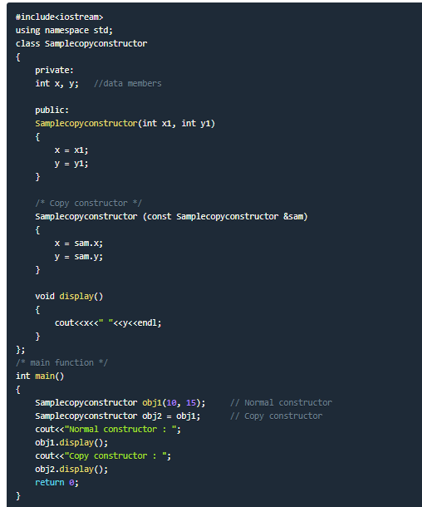

Slide 9
The Class Destructor
A destructor is a special member function of a class that is executed whenever an object of it's class goes out of scope or whenever the delete expression is applied to a pointer to the object of that class.
A destructor will have exact same name as the class prefixed with a tilde (~) and it can neither return a value nor can it take any parameters. Destructor can be very useful for releasing resources before coming out of the program like closing files, releasing memories etc.

Slide 10
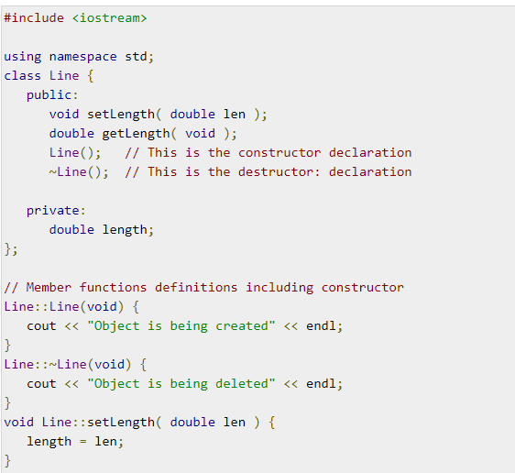
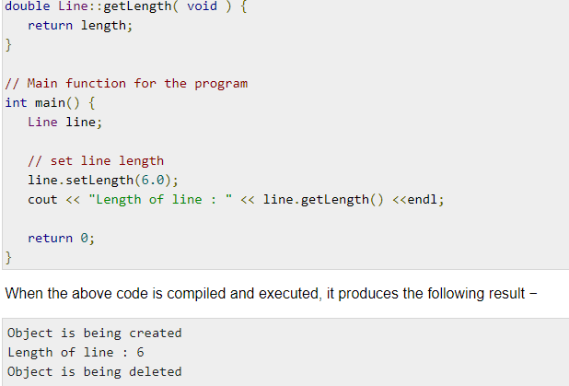

Slide 11
Constructor Overloading in C++
Just like other member functions, constructors can also be overloaded. Infact when you have both default and parameterized constructors defined in your class you are having Overloaded Constructors, one with no parameter and other with parameter.
You can have any number of Constructors in a class that differ in parameter list.
In above case we have defined two constructors with different parameters, hence overloading the constructors.
One more important thing, if you define any constructor explicitly, then the compiler will not provide default constructor and you will have to define it yourself.
In the above case if we write Student S; in main(), it will lead to a compile time error, because we haven't defined default constructor, and compiler will not provide its default constructor because we have defined other parameterized constructors.

Slide 12
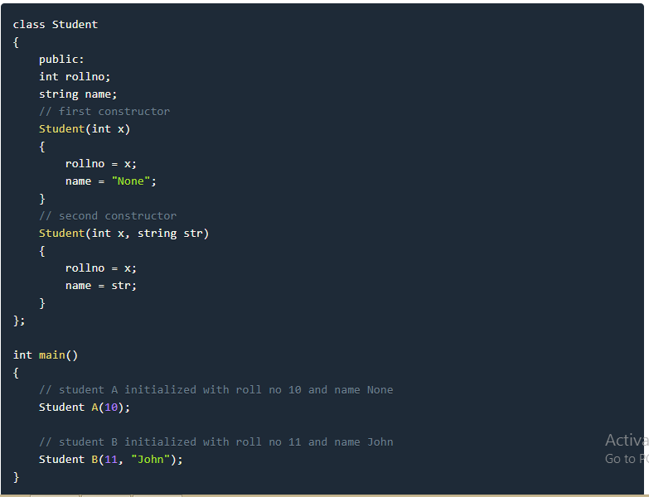

Slide 13
Function Overloading
Function overloading is a C++ programming feature that allows us to have more than one function having same name but different parameter list, when I say parameter list, it means the data type and sequence of the parameters,
for example the parameters list of a function myfuncn(int a, float b) is (int, float) which is different from the function myfuncn(float a, int b) parameter list (float, int). Function overloading is a compile-time polymorphism.
E.g sum(int num1, int num2)
sum(int num1, int num2, int num3)
sum(int num1, double num2)

Slide 14
Static Keyword
Static is a keyword in C++ used to give special characteristics to an element.
Static elements are allocated storage only once in a program lifetime in static storage area. And they have a scope till the program lifetime. Static Keyword can be used with following,
Static variable in functions
Static Class Objects
Static Variable in class
Static functions in class

Slide 15
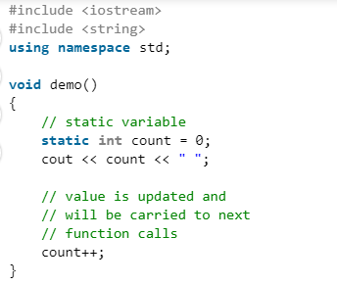
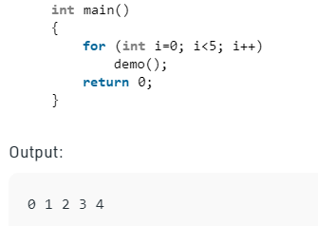
Static variables in a function
When a variable is declared as static, space for it gets allocated for the lifetime of the program.
Even if the function is called multiple times, space for the static variable is allocated only once and the value of variable in the previous call gets carried through the next function call.

Slide 16
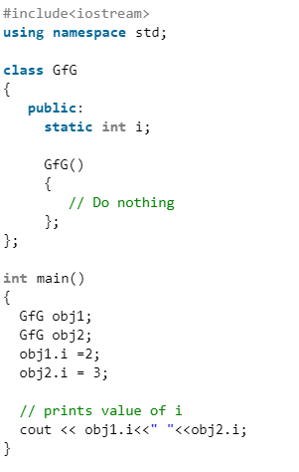
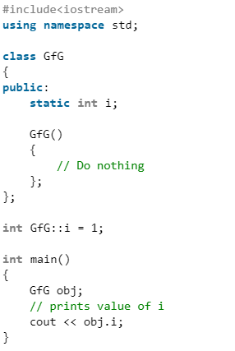
Static Variable in class
As the variables declared as static are initialized only once as they are allocated space in separate static storage so, the static variables in a class are shared by the objects.
There can not be multiple copies of same static variables for different objects.
Also because of this reason static variables can not be initialized using constructors.

Slide 17
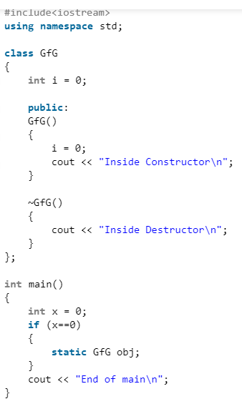
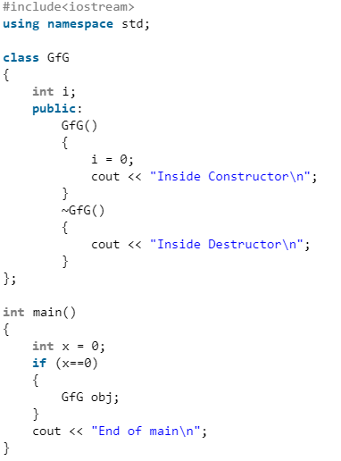
Static Class Objects
Just like variables, objects also when declared as static have a scope till the lifetime of program.

Slide 18
Static functions in class
Just like the static data members or static variables inside the class, static member functions also does not depend on object of class.
We are allowed to invoke a static member function using the object and the ‘.’ operator but it is recommended to invoke the static members using the class name and the scope resolution operator.
Static member functions are allowed to access only the static data members or other static member functions, they can not access the non-static data members or member functions of the class.

Slide 19
